Slide 1
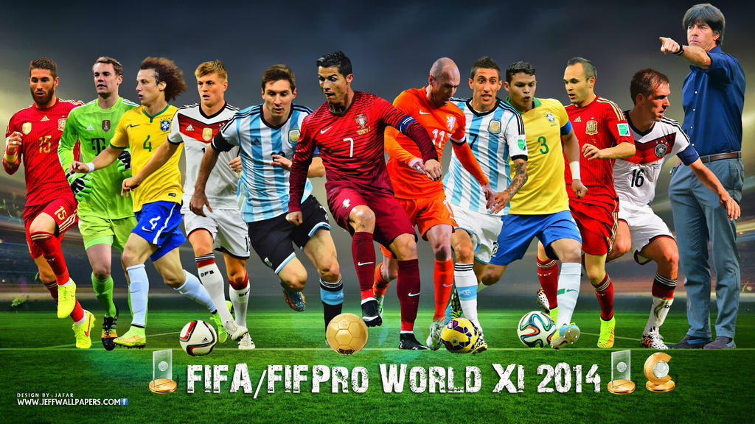
FIFA WORLD CUP ANALYSIS

Slide 2
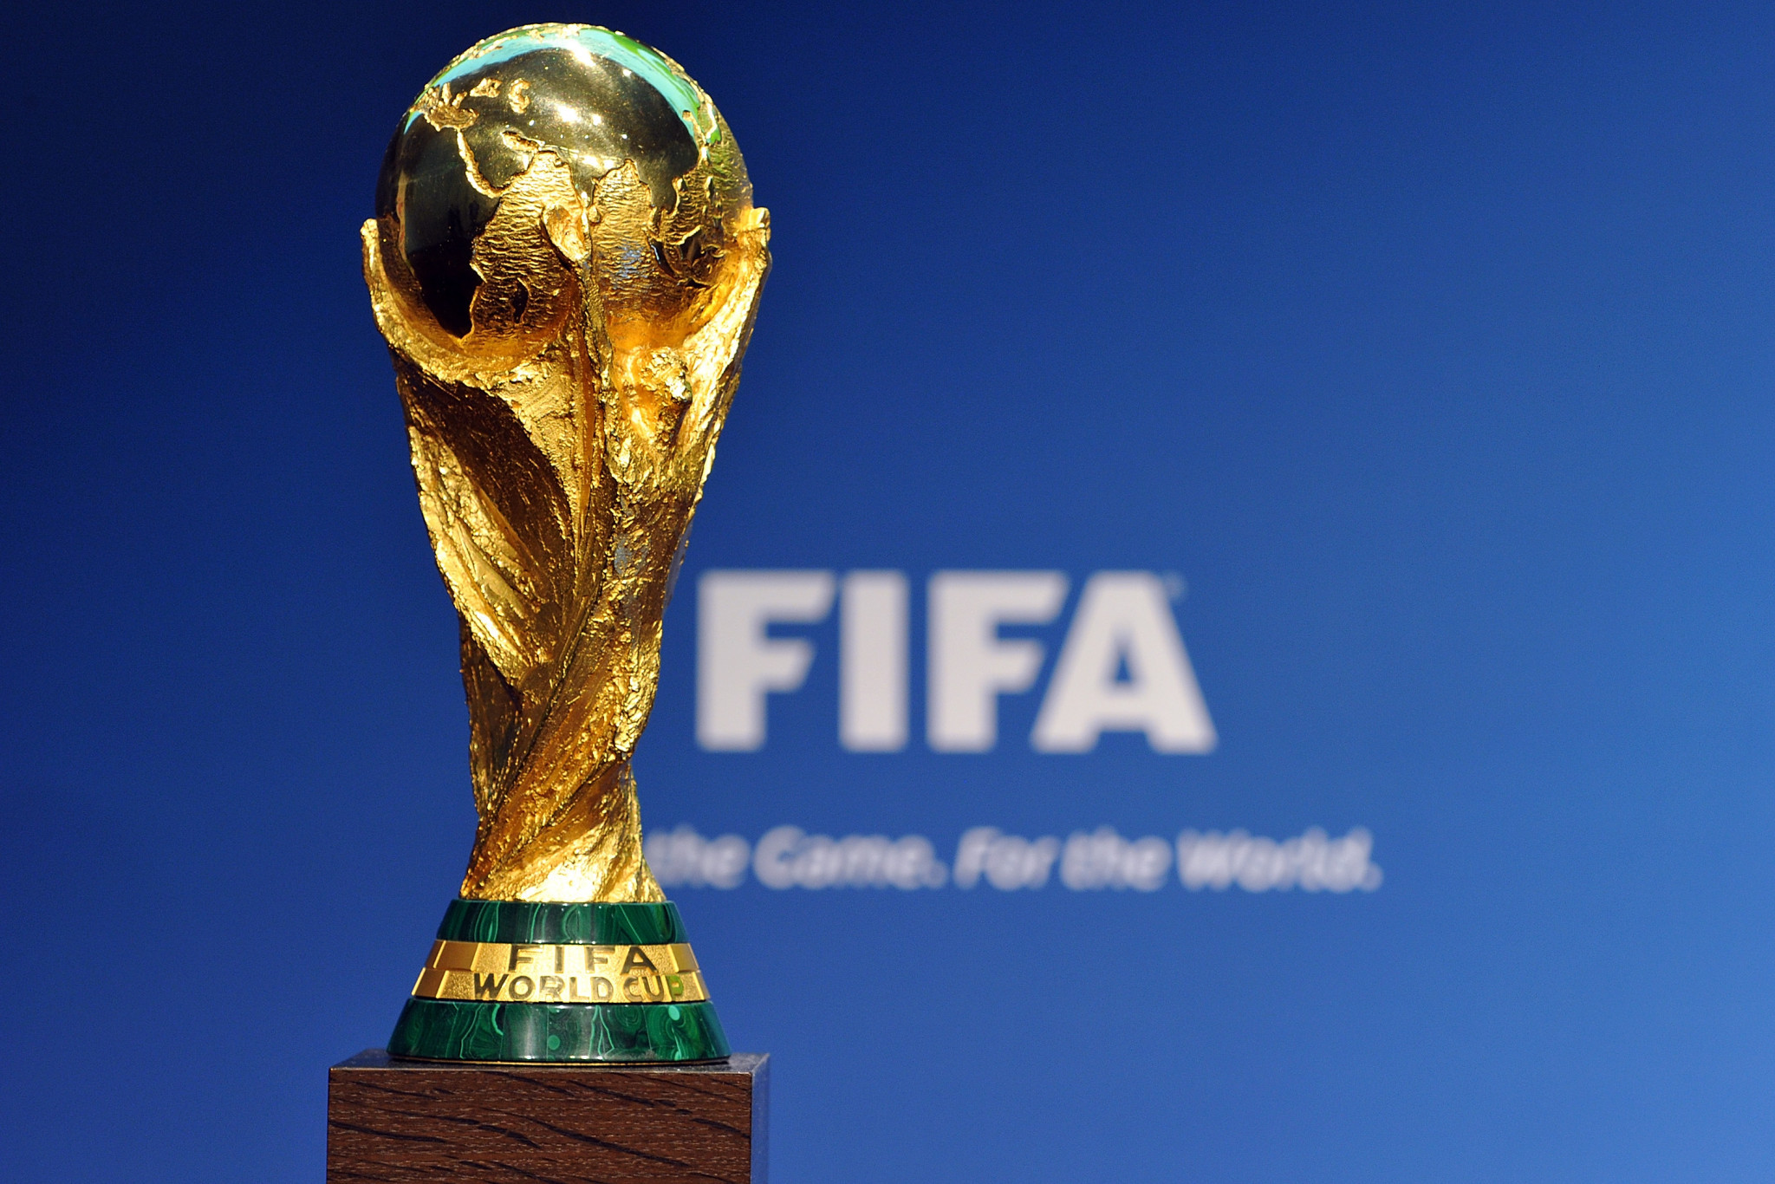
CONTENT
01. Introduction
02. Data Cleaning
03. Exploratory Analysis
04. Hidden Insights from the data
05. Dream Team Analysis
06. Conclusions

Slide 3

INTRODUCTION
Fédération Internationale de Football Association [FIFA]
Non-Profit Organization
Problem Statement:
Analyse the dataset and identify the best players across different parameters.
How?
Using different data visualization techniques in Python and draw hidden insights from the data.

Slide 4
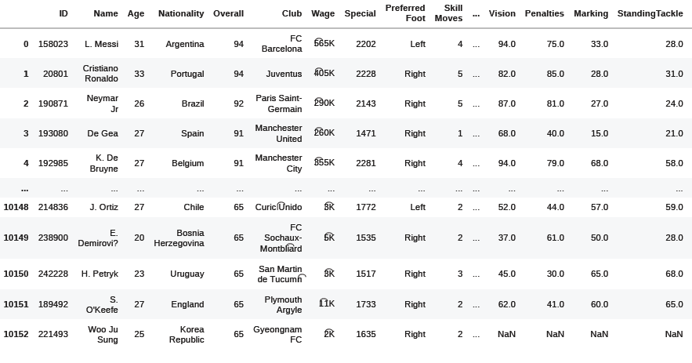
DATA IMPORTATION AND CLEANING
Import the dataset into Jupyter notebook by using libraries ( NumPy, pandas, seaborn and matplotlib).
Dataset – Downloaded from Kaggle – Converted into csv format
Data Cleaning Procedure:
Unwanted Columns are removed using drop function from pandas library.
Unwanted Columns Names : Club Logo', 'Potential’ ,'Jersey Number’, 'Photo’,’ Flag’, etc.
Pre-Cleaning Dataset Dimensions : 10153 rows × 89 columns
Post Cleaning Dataset Dimensions: 9991 rows × 44 columns

Slide 5
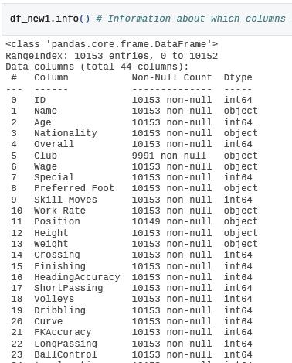
DATA HANDLING
Information about which columns have contained how many NON-NULL values, so that we can delete those rows of which contains NULL values.
We have dropped those rows which contain null values because our sample size is very large and dropping few rows wont affect our analysis.
Hence, we want to make all the columns of the same count (as Club column).

Slide 6
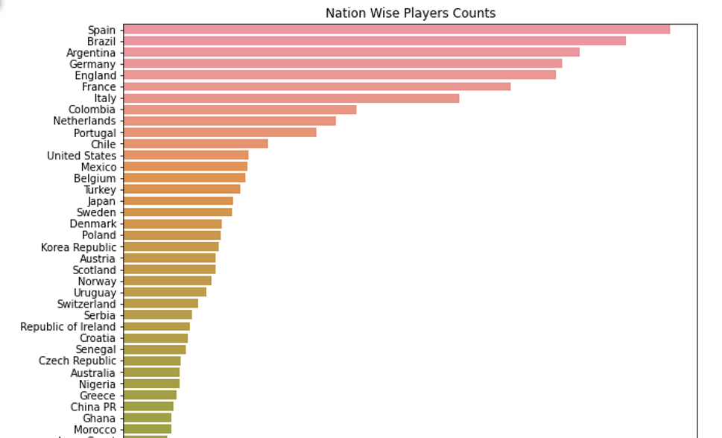
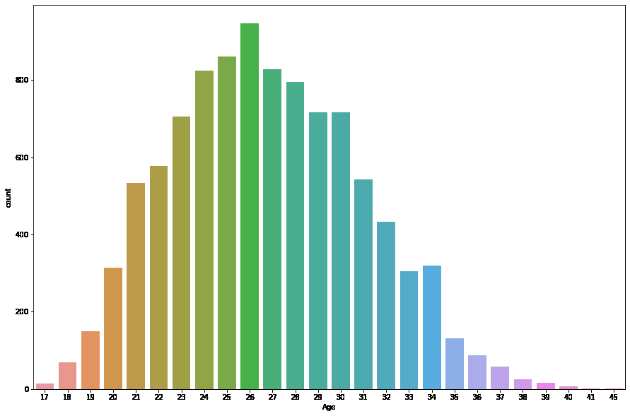
EXPLORATORY ANALYSIS
Count of Nation Wise Players (BarPlot)
Age Distribution of Players (CountPlot)

Slide 7
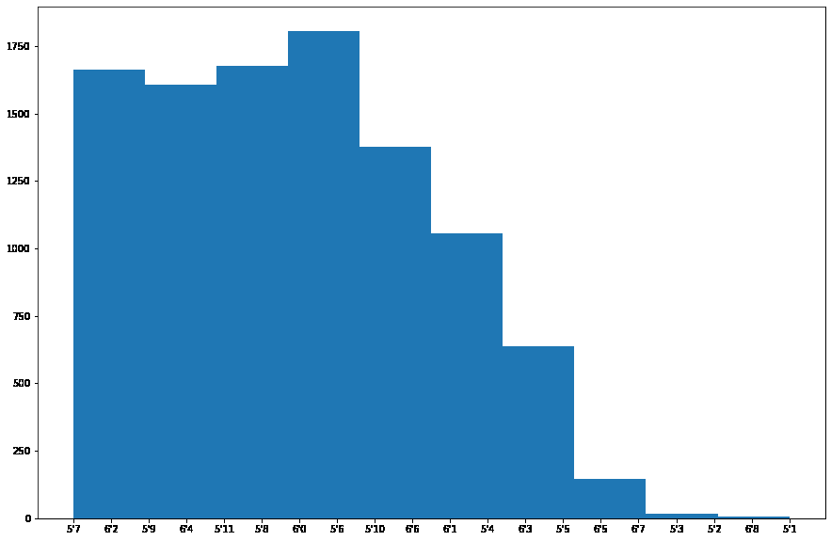
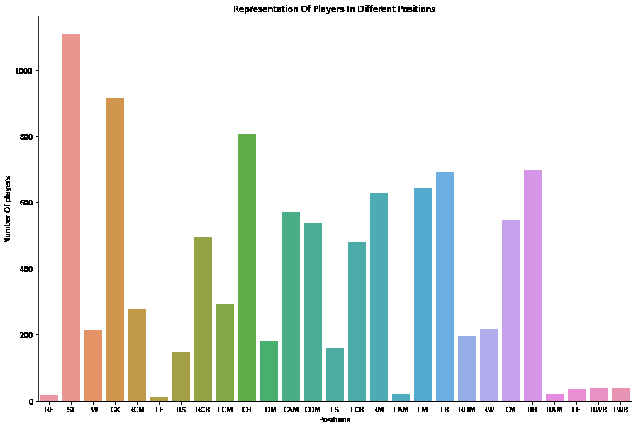
EXPLORATORY ANALYSIS
Height Distribution of Players (Histogram)
Representation Of Players In Different Positions

Slide 8
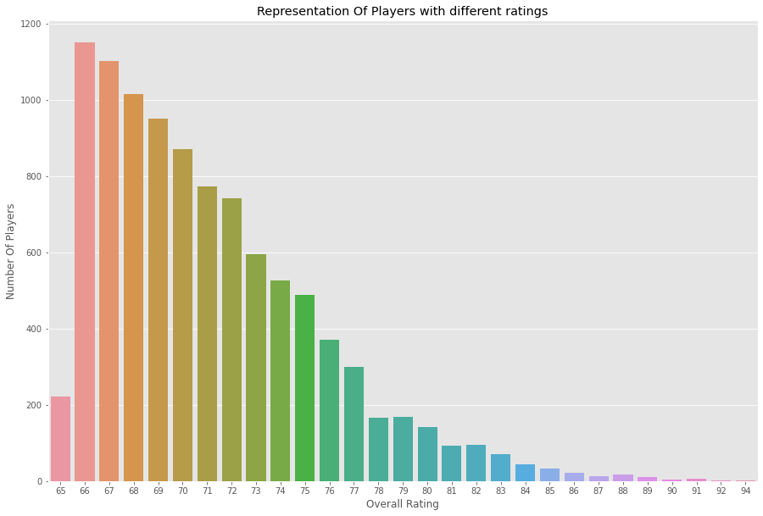
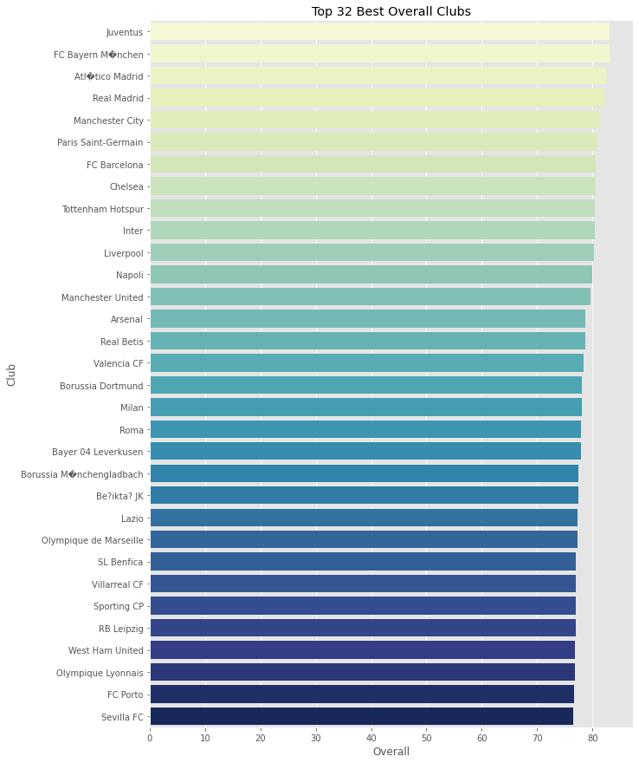
EXPLORATORY ANALYSIS
Representation Of Players with Different Overall Ratings
Top 32 Football Clubs

Slide 9
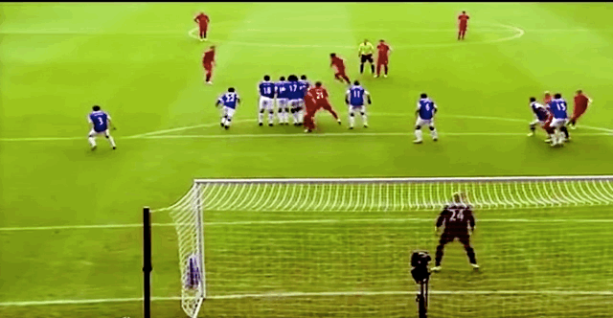
DREAM TEAM ANALYSIS
Selection Criteria:
Average Goalkeeping Score: GKDiving, GKHandling, GKKicking, and GKReflexes.
Average Striker Score: Finishing, Heading, Accuracy, Free Kick Accuracy, Sprint Speed, etc.
Average Defender Score: Crossing , Short Passing, LongPassing and Acceleration, etc.
Average Mid-Fielding Score: Volleys, Dribbling, Curve, Balance, etc.

Slide 10
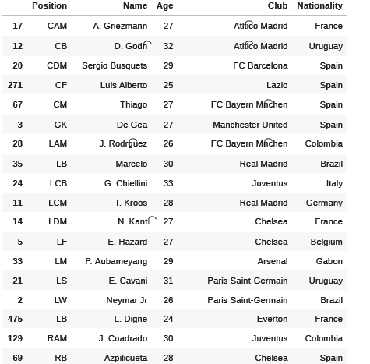
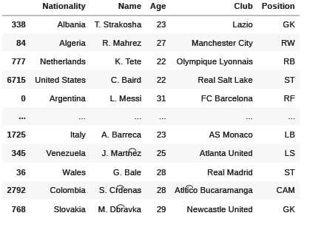
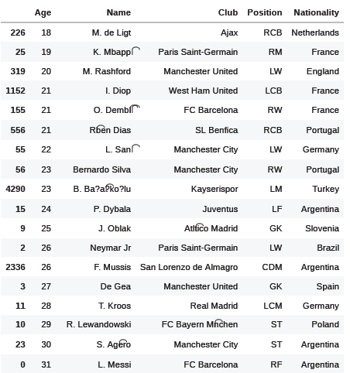
Best Player Based On Parameters
Position
Nationality
Age

Slide 11
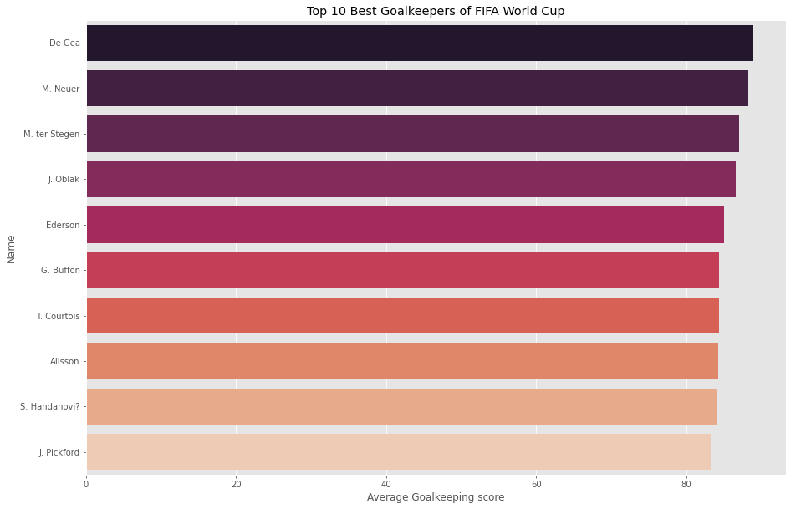
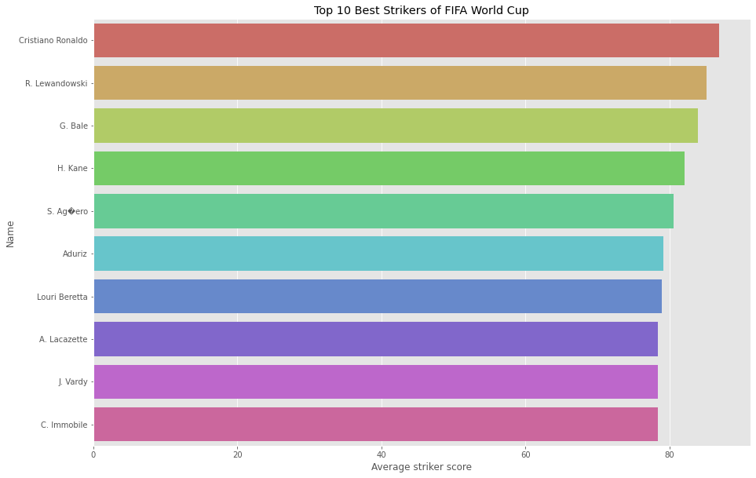
Top 10 Players (Graphical Representation)

Slide 12
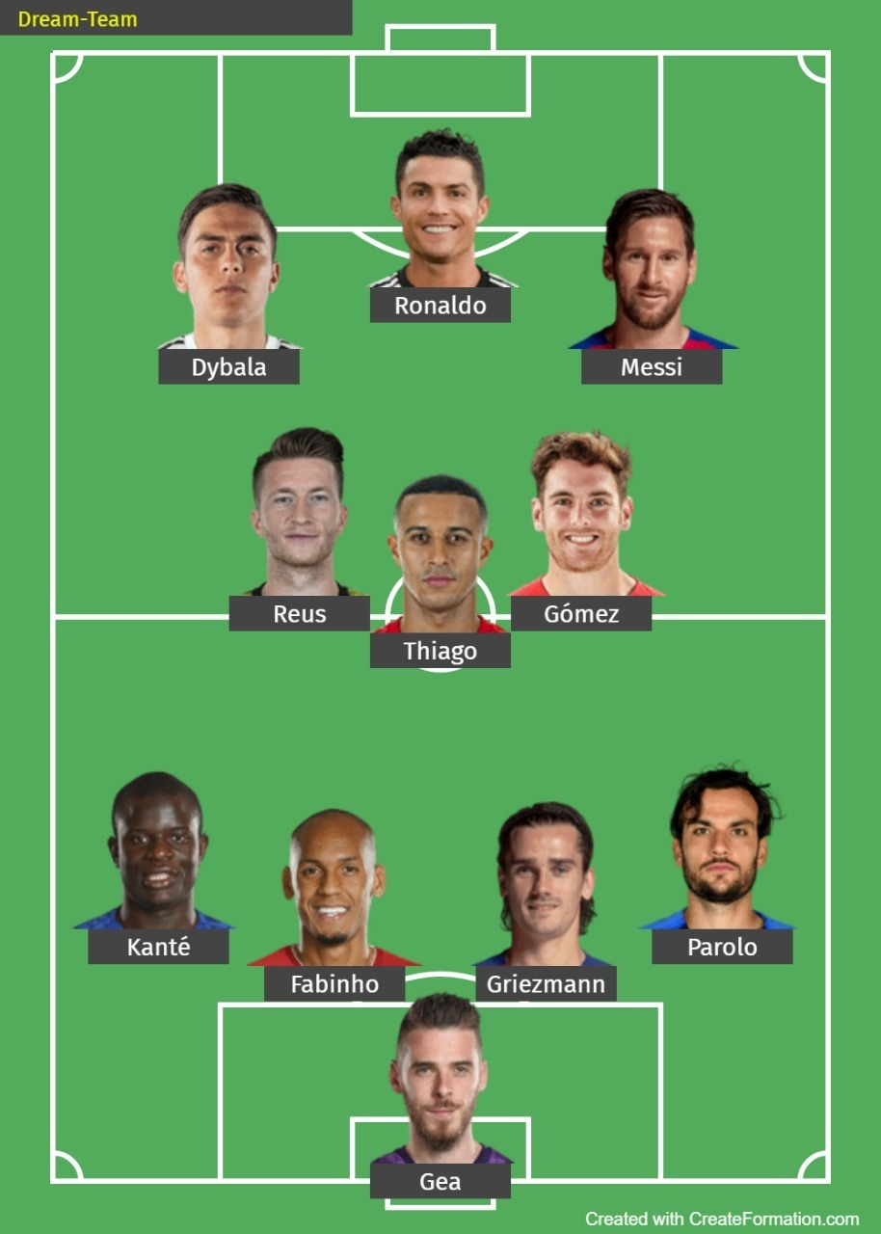
DREAM TEAM
Best Striker : Ronaldo
Best Center Defender: Fabinho
Best Right Forward Striker: Messi
Best Right Defender: Parolo
Best Left Forward Striker: Dybala
Best Left Defender: Kante
Best Center Midfielder: Thiago
Best Center Defender : Griezmann
Best Right Midfielder: Gomez
Best Goal Keeper: Gea
Best Left Midfielder: Reus

Slide 13
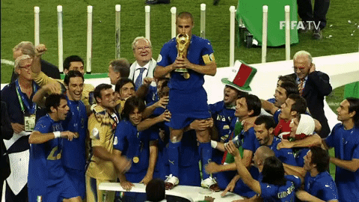
CONCLUSION
147 Countries
Maximum Player Representation (Nationality) –
Spain > Brazil > Argentina
Maximum Player Representation (Position) -
Strikers > Goalkeepers > Central Defenders
¾ th of the Players are Right Footed.
Youngest Player – M. De Ligit ( 18 yrs. - Right Defender – Ajax Club)
Oldest Player – G. Buffon ( 40yrs – Goalkeeper – Paris Saint Germain)
Juventus – Highest Overall Rated Club
Who would benefit from the Analysis?
Team Managers
Fantasy League Players

